Slide 1

May 2018
Bangalore
Data Visualisation using ggplot2 in R
May 2018
Bangalore

Slide 2
Why ggplot2
➢ Consistent underlying grammar of graphics (Wilkinson, 2005)
➢ Plot specification at a high level of abstraction
➢ Very flexible
➢ Theme system for polishing plot appearance
➢ Mature and complete graphics system
➢ Many users, active mailing list

Slide 3
What is ggplot2
➢ The ggplot2 package, created by Hadley Wickham, offers a powerful graphics language for creating elegant and complex
plots.
➢ Its popularity in the R community has exploded in recent years.
➢ There is a helper function called qplot() (for quick plot) that can hide much of this complexity when creating standard
graphs.

Slide 4
What is ggplot2
What is Machine Learning
➢ Independently specify plot building blocks and combine them to create just about any kind of graphical display you
want. Building blocks of a graph include:
• Data
• Aesthetic mapping
• Geometric object
• Statistical transformations
• Scales
• Co-ordinate system
• Position adjustments
• Faceting

Slide 5
What is ggplot2
What is Machine Learning
➢ ggplot works with dataframes and not individual vectors.
➢ All the data needed to make the plot is typically be contained within the dataframe supplied to the ggplot() itself or can
be supplied to respective geoms.
➢ you can keep enhancing the plot by adding more layers (and themes) to an existing plot created using
the ggplot() function.
➢ Let’s take an inbuilt dataset to create some examples.

Slide 6
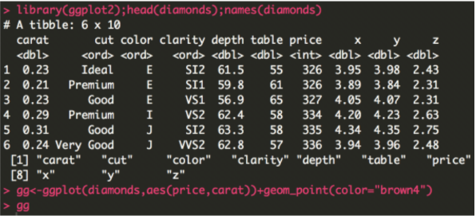
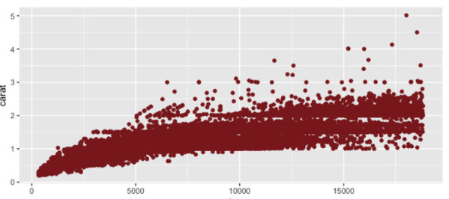
Data Visualisation Using ggplot2

Slide 7

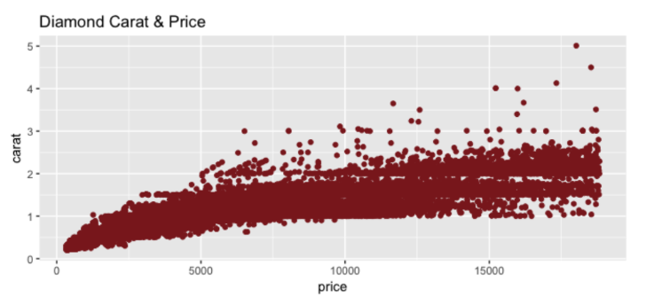
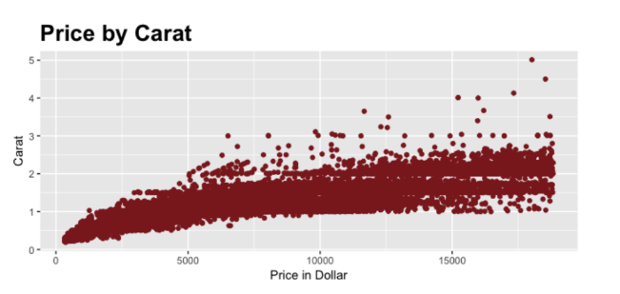
Data Visualisation Using ggplot2

Slide 8
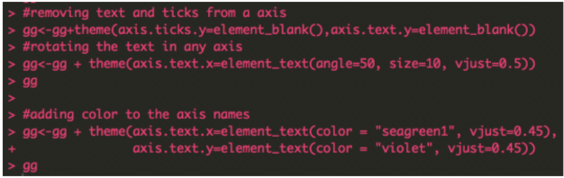
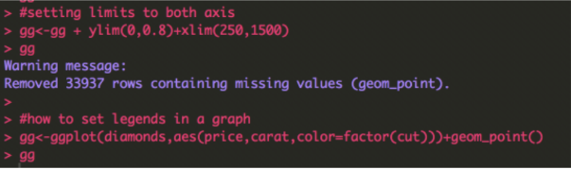
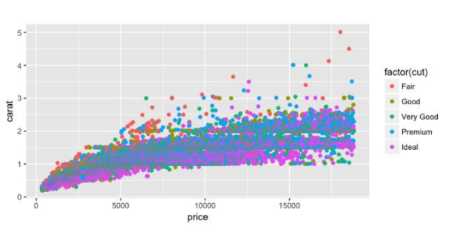
Data Visualisation Using ggplot2

Slide 9
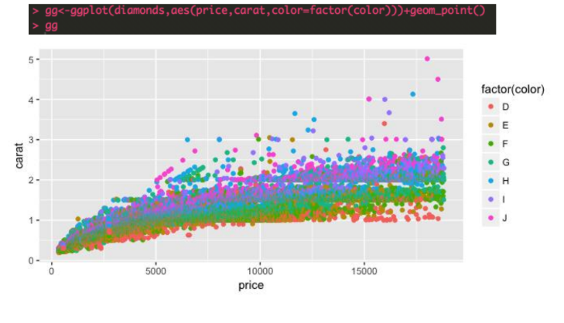
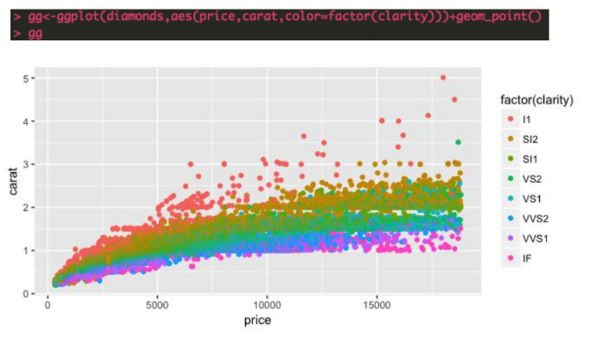
Data Visualisation Using ggplot2

Slide 10
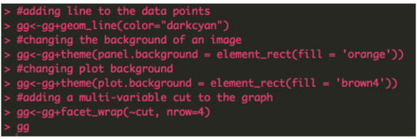
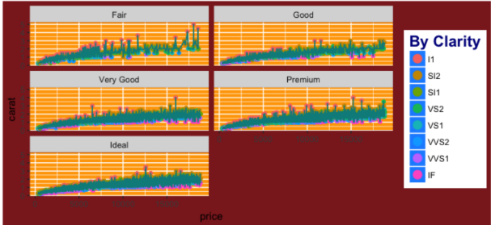
Data Visualisation Using ggplot2

Slide 11
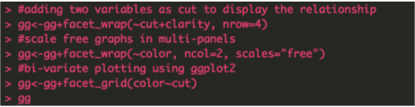
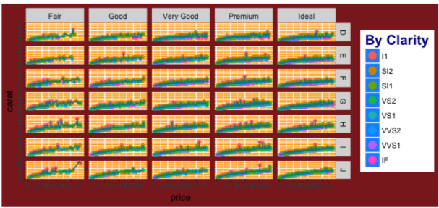
Data Visualisation Using ggplot2

Slide 12
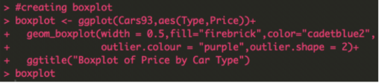
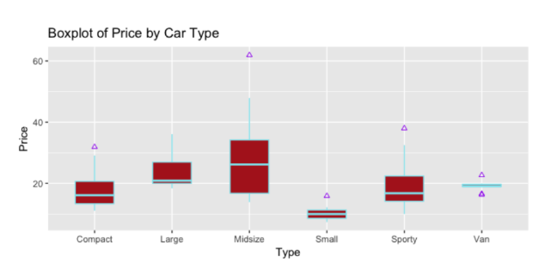
Data Visualisation Using ggplot2

Slide 13
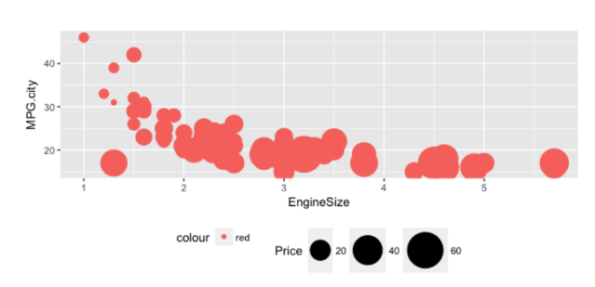
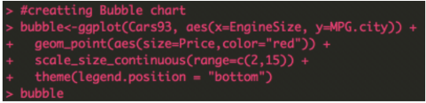
Data Visualisation Using ggplot2

Slide 14
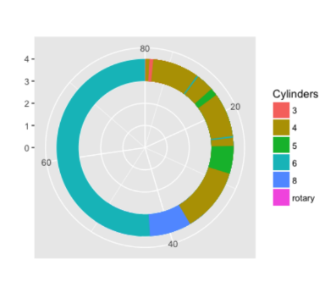

Data Visualisation Using ggplot2

